Slide 1

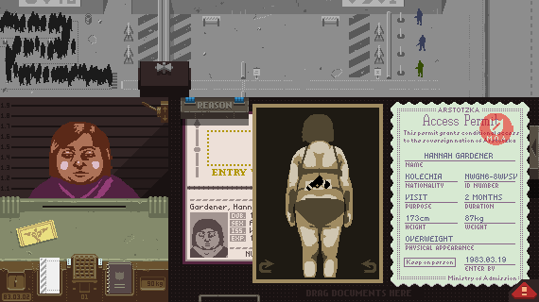
Games as Social Commentary: Politics, Gender Representation, and Ethics
Games: Papers, Please (2013)
For the political part of the question, I will use Papers, Please (2013) as a reference due to its references and commentary on the politics and state of the world of the soviet society.
To complete my research, I will either play the game or watch a gameplay to fully understand how it works and further reference my essay on not only the narrative, but also the technical standpoint as it may further prove my points and give me some interesting insights.

Slide 2

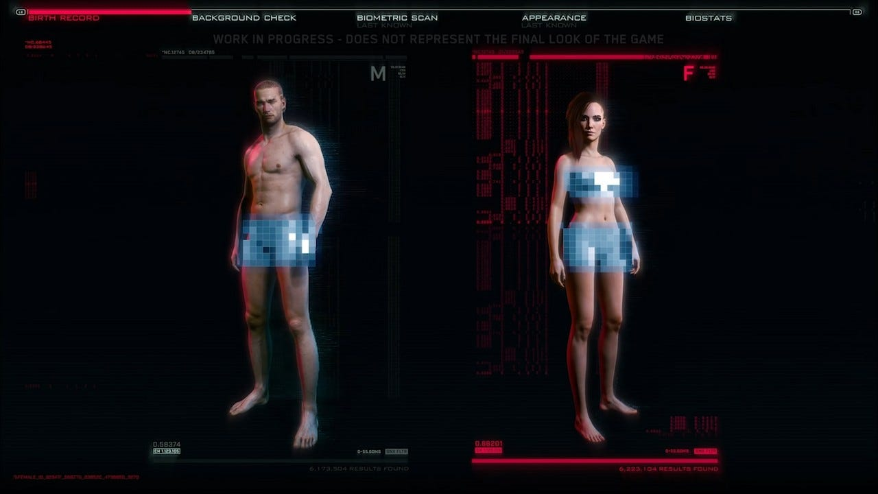
Games as Social Commentary: Politics, Gender Representation, and Ethics
Cyberpunk 2077
Cyberpunk 2077 is a game I plan to research further and reference when talking about positive gender representation in gaming. Due to their well use of gender identity in the game through the characters, every gender is included, even transgender people are given some spotlight which is very rare for the game industry, especially triple A games to delve into.
To gain further research I will either try to play it myself or watch a playthrough of to further understand the gameplay of it. It will be a good comparison of the direction the gender representation in gaming should move forward to.

Slide 3
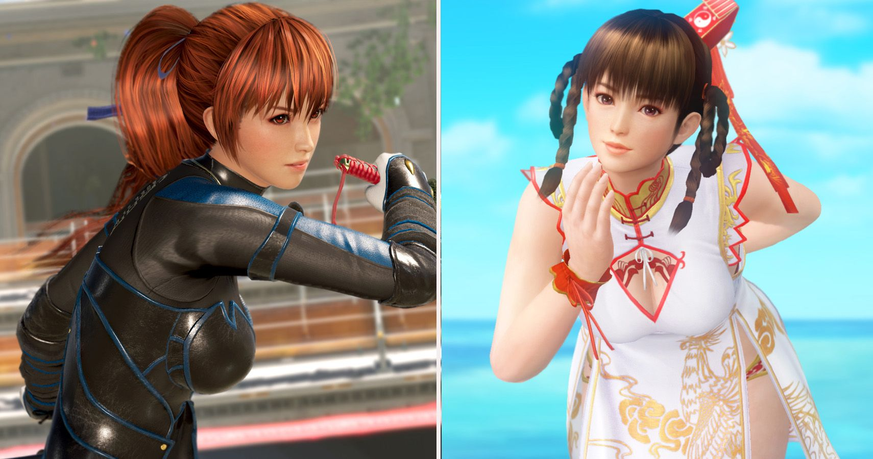
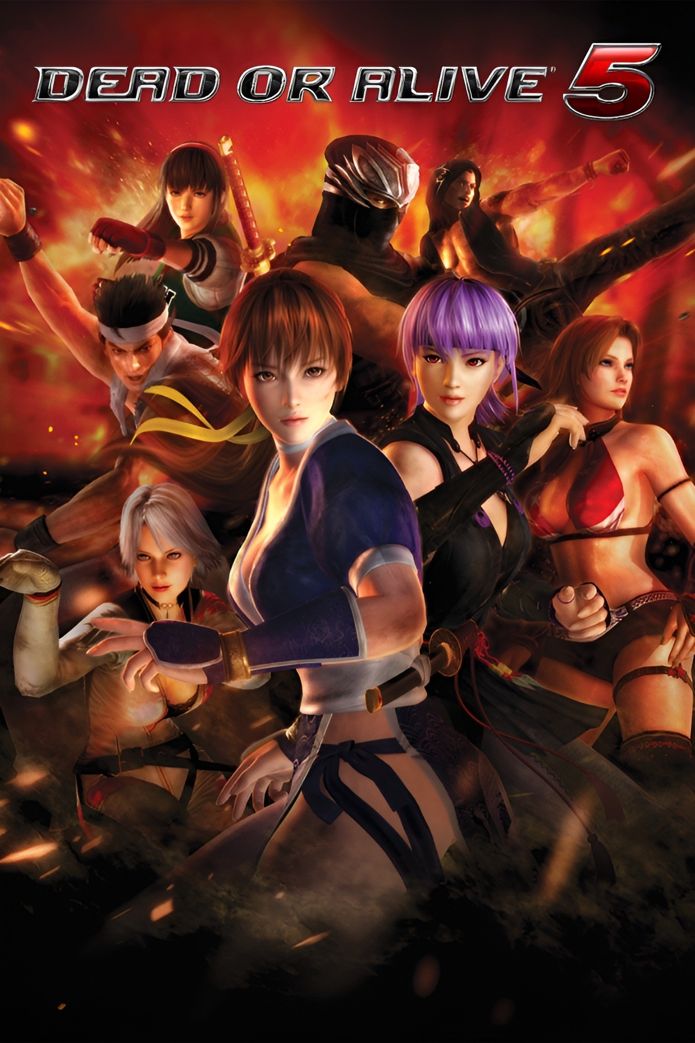
Games as Social Commentary: Politics, Gender Representation, and Ethics
Dead or Alive
Dead or Alive series would be an example of game to investigate of what not to do when it comes to gender representation. The game is known for its objectification of women and being heavily male gaze centred.
It would be a good parallel with the cyberpunk games, and how not to make female characters. I will investigate gameplays and articles of it as further research.

Slide 4
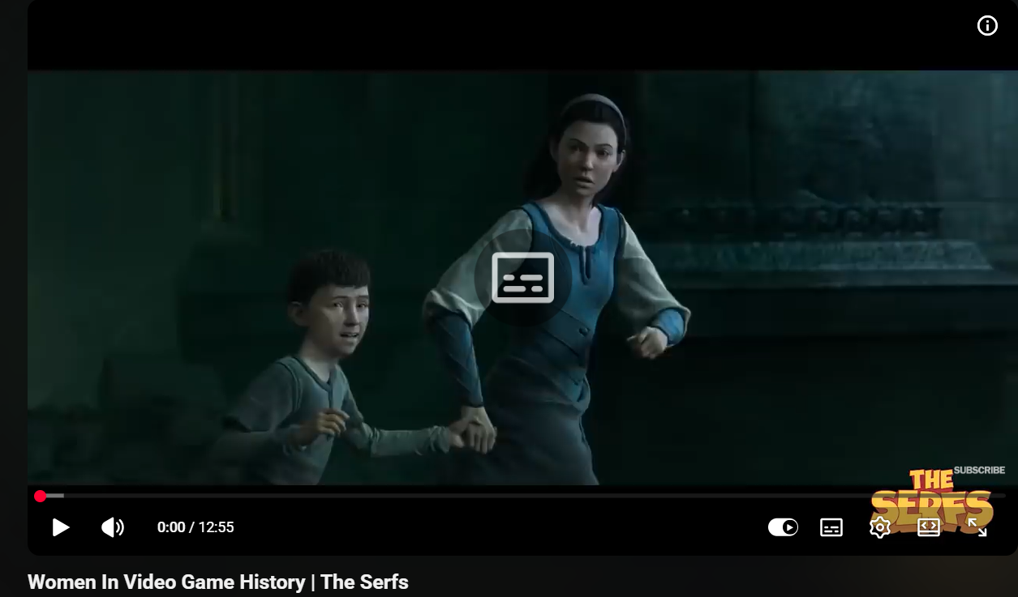
Games as Social Commentary: Politics, Gender Representation, and Ethics
Women In Video Game History | The Serfs
I will use this video essay as a basis for my essay on gender representation in games as it goes into the history of female representation in detail, all the way back to the creation of the female packman, and how it has progressed through the years with the making of Tomb Raider, and the more positive representation of the walking dead, and the lesbian relationship a female character has with another.
This will greatly aid me as I will be able to further my essay question.
https://youtu.be/1PRY9vhnQxs?si=aEU-EKJBycHg7BNK

Slide 5
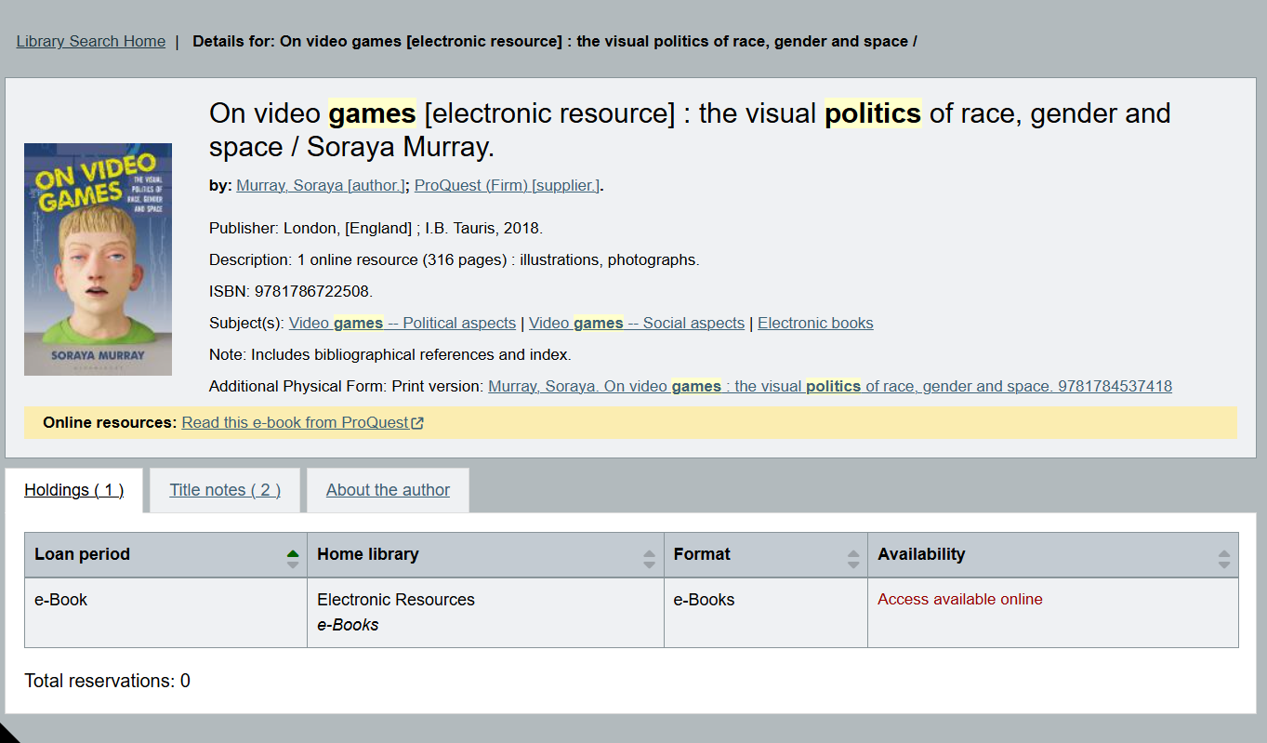
Games as Social Commentary: Politics, Gender Representation, and Ethics
On video games the visual politics of race, gender and space / Soraya Murray.
This E-Book will help me when it comes to the political stance of games and how creators put it in games. It also talks about gender and race which benefits my essay even further on the social stance of the question.
It would give me a more detailed stance and benefit the games I will be mentioning in the essay.

Slide 6
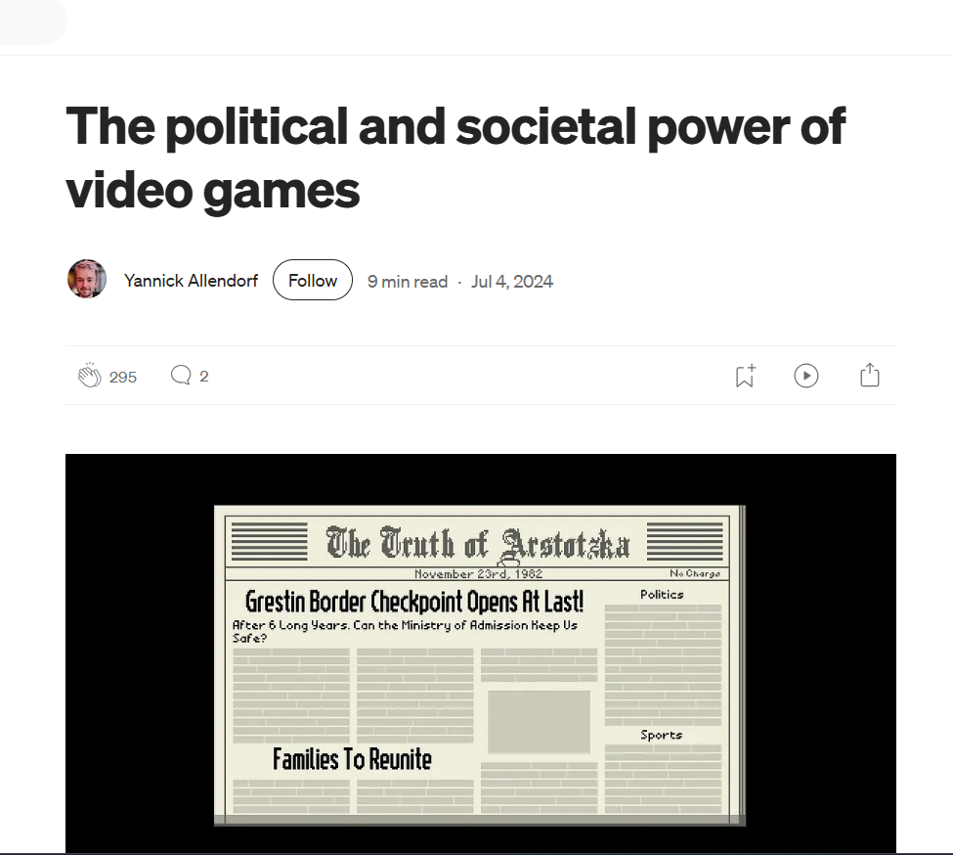
Games as Social Commentary: Politics, Gender Representation, and Ethics
The political and societal power of video games
I will use this article as a basis of political and societal uses in video games; it especially dives in into the game papers please and really talks about how it impacts the world and what had impacted it as well. This will be a very interesting read to investigate and feature in my essay.
https://uxdesign.cc/the-political-and-societal-power-of-video-games-ac2c6dab295e

